Slide 1
Python Programming

Slide 2
Identifiers and Constants
Identifiers:
Sequence of one or more characters used to name a program element.
Eg: Variables, Functions, String, List etc…
Rules for Identifier:
Case Sensitive
May contain letters and digits, starts with a character
Only ‘_’ is considered, no other special characters are allowed
Spaces & keywords are not allowed

Slide 3
Identifiers and Constants
Variables:
Variables are container that hold data.
Variable is a name associated with a value.
Comments:
Single line comment - #
Multi line comment - “““………..””” or ‘‘‘ ……..’’’

Slide 4
Identifiers and Constants
Constants:
The value that will not change throughout the execution of the program.
Types of Constants:
Numeric Constants (Integer or Float)
Eg: 100, 10.5
String Constants
Eg: “Hello World” or ‘Hello World’

Slide 5
Input and Output Functions
Input Function:
input()
Data = input()
Data = input(“Enter the number”)
Data = int(input(“Enter the number”))
Data = float(input(“Enter the cost”))
Output Function:
print(“Hello”)
print(sum)
print(“The total is”, sum)
print(round(pi,2))
  print(“%10.2f”%pi)

Slide 6
Data Types
Data Types in Python:
Boolean, None, Numbers, Strings, Tuples, Sets, Lists
Boolean:
A = 10 > 5
A has the value True
None:
To check for emptiness

Slide 7
Data Types
Numbers:
Integers a=5
Floating point numbers b=3.55
Complex numbers c=4+3j
Binary (base 2) 0b1, 0b1001
a=0b1001
print(a)
Output: 9
Octal (base 8) 0o1, 0o20
b=0o456
print(b)
Output: 302

Slide 8
Data Types
Conversion between different bases:
oct(64)
0o100
hex(64)
0x40
bin(64)
0b1000000

Slide 9
Operators in Python
Arithmetic Operators
  + - * / // %
  Relational Operators
  > >= < <= == !=
  Logical Operator
  and or not
  Assignment Operator
  =
  Bitwise Operator
  & | ^ >> << ~

Slide 10
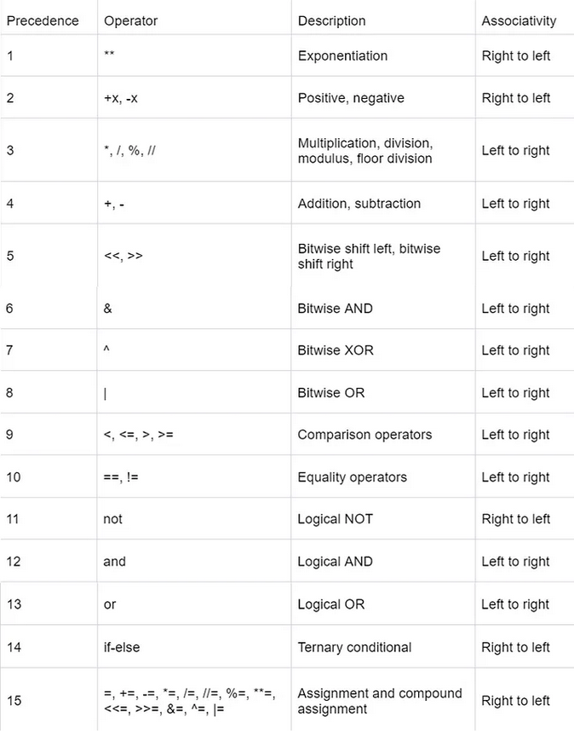
Operator Precedence

